Slide 1
The Assimilation of IASI Radiances in the Nordic MetCoOp Limited-area NWP system
Reima Eresmaa¹, Magnus Lindskog², Ole Vignes³
¹Finnish Meteorological Institute
²Swedish Meteorological and Hydrological Institute
³MET Norway

Slide 2
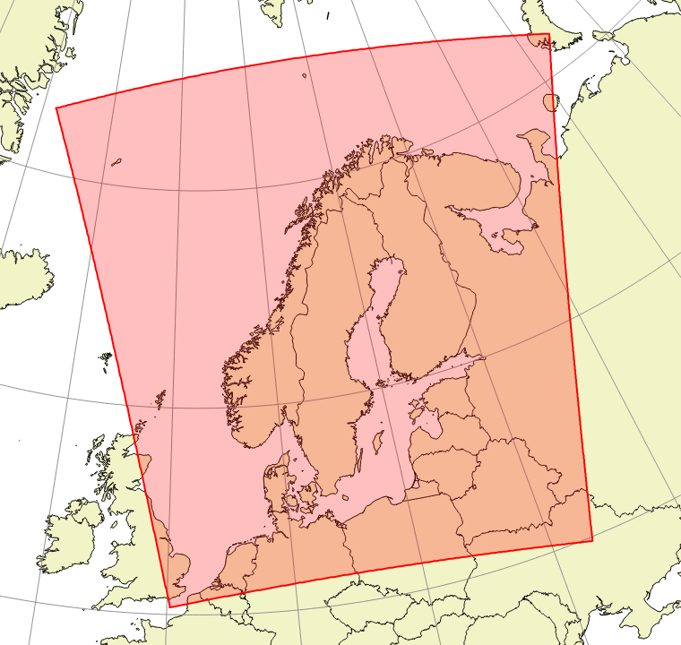
The Operational MetCoOp NWP System
MetCoOp: Meteorological Co-operation on Operational NWP
→Participants include Estonia, Finland, Norway, and Sweden
→Operational phase ongoing since March 2014
MEPS: MetCoOp Ensemble Prediction System
→960 x 1080 grid points; 2.5 km horizontal spacing
→65 layers in vertical going from 12 m to 10 hPa
→Lateral boundary condition from hourly forecast of the ECMWF global model
→3-hourly cycled analysis based on the 3D-Var assimilation scheme
→Forecast output at 1-hour resolution up to 66-hour lead time
→Deterministic (unperturbed) run 8 times a day (at 00Z, 03Z, …, 21Z)
→Lagged ensemble of 14 perturbed members (launching a total of 5 new members at every hour)
Müller et al. (2017), AROME-MetCoOp: A Nordic Convective-Scale Operational Weather Prediction Model, https://doi.org/10.1175/WAF-D-16-0099.1

Slide 3
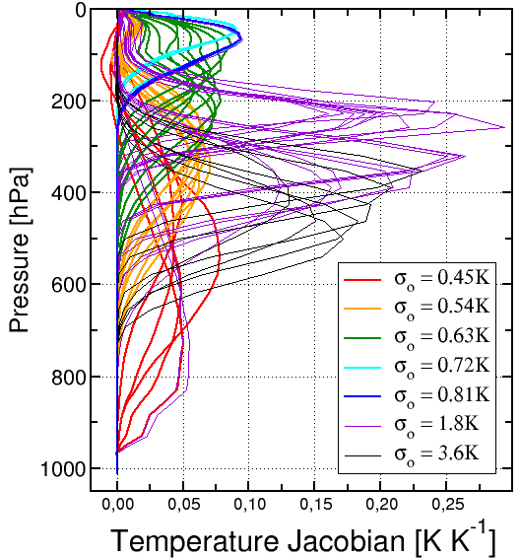
The use of IASI in the MetCoOp NWP system
Metop-A 11/2015 – 06/2021
Metop-B 11/2015 – present
Metop-C 06/2021 – present
In many respects similar to the implementation in the Meteo-France limited-area model (AROME)
→Active use of 55 channels
→Variational bias correction with ~standard set of predictors (but no stratospheric thicknesses)
→Horizontal data thinning to 60 km minimum separation
→Uncorrelated observation errors
→IASI data assimilated at 08–13 UTC (descending nodes) and 16–22 UTC (ascending nodes)

Slide 4
Metop-B data coverage inside the MEPS domain
09 UTC
12 UTC
18 UTC
21 UTC

Slide 5
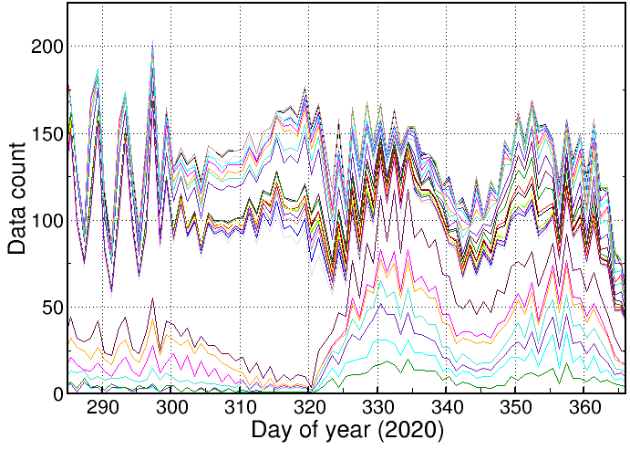
The impact of bias correction on detection of cloud
Change in a pre-operational MetCoOp NWP system
Stratospheric channels
Lower-tropospheric channels
→ Improved sampling of troposphere since October 2020

Slide 6
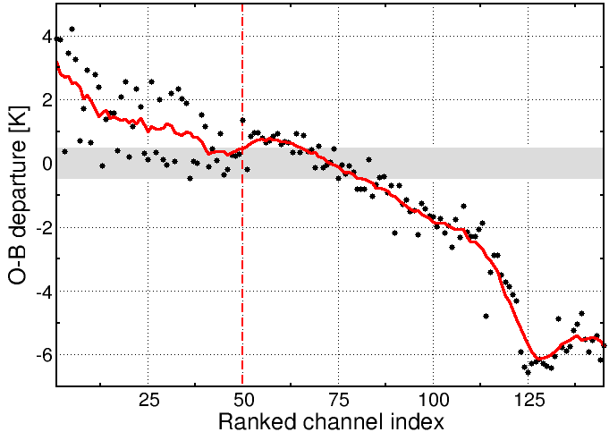
The impact of bias correction on detection of cloud
Clear channels
Cloudy channels
McNally and Watts cloud detection (2003):
– Take a large number of channels from the 15 μm (long-wave IR sounding band
– Rank O-B departures in vertical and apply a smoothing filter
– Find the ”breaking point” that marks the distinction between clear and cloud-affected channels
McNally & Watts (2003): A cloud detection algorithm for high-spectral-resolution infrared sounders. https://doi.org/10.1256/qj.02.208

Slide 7
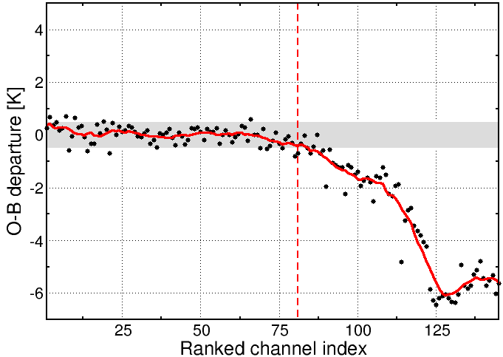
The impact of bias correction on detection of cloud
Clear channels
Cloudy channels
McNally and Watts cloud detection (2003):
– Take a large number of channels from the 15 μm (long-wave IR sounding band
– Rank O-B departures in vertical and apply a smoothing filter
– Find the ”breaking point” that marks the distinction between clear and cloud-affected channels
– For best results do this with bias-corrected O-B departure data!

Slide 8
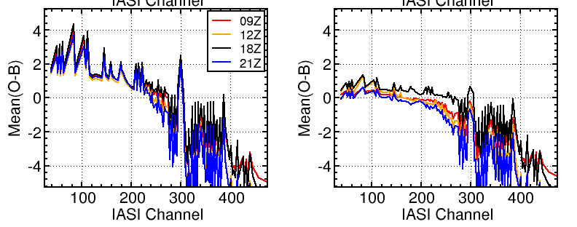
The challenge of Variational bias correction (VarBC)
Before correcting for bias
After correcting for bias
Up to 4K bias on stratospheric channels
Uncorrected statistics are similar at all analysis hours …
… but bias-corrected statistics are not
→How to prevent VarBC from correcting for background-model bias in a limited-area model ?

Slide 9
Analysis-hour specific sets of VarBC coefficients (as it stands in the MetCoOp system)
Analysis hour
Day of month
11/00
11/03
11/06
11/09
11/12
11/15
11/18
11/21
12/00
12/03
12/06
12/09
12/12
12/15
12/18
12/21
13/00
13/03
13/06
13/09
13/12
13/15
13/18
13/21
14/00
14/03
14/06
14/09
14/12
14/15
14/18
14/21
Including active use of Metop satellites
Background field information in 3-hourly cycling
Background VarBC information in 24-hourly cycling

Slide 10
Unified VarBC coefficients (a possible future implementation; currently in testing)
Analysis hour
Day of month
11/00
11/03
11/06
11/09
11/12
11/15
11/18
11/21
12/00
12/03
12/06
12/09
12/12
12/15
12/18
12/21
13/00
13/03
13/06
13/09
13/12
13/15
13/18
13/21
14/00
14/03
14/06
14/09
14/12
14/15
14/18
14/21
Including active use of Metop satellites
Background field information in 3-hourly cycling
Passing VarBC coefficients without updating them
Transferring updated VarBC coefficients after 09Z analysis only

Slide 11
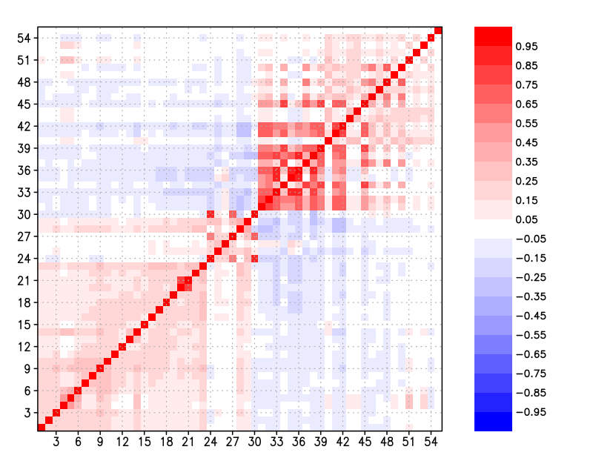
Next steps towards improved use of IASI
T sounding
Q sounding
(1) Determine the best updating strategy for VarBC coefficients
(2) Update the observation error covariance matrix to 2020’s
→ Modelling of spectrally-correlated error
→ Diagnostic-based observation error variance description
(3) Consider making use of more than 55 channels
T sounding
Q sounding

Slide 12
Summary
1) Recent performance improvement from including the cloud-detection channels in bias correction
2) Current work focusing on revising the VarBC update strategy
→ Aiming to reduce the extent to which VarBC corrects for model background biases
3) Updating the observation error covariance matrix to follow in the near future
→ To include diagnostic-based variance and inter-channel correlations

Slide 13
MetCoOp satellite data use in December 2021
Spacecraft | Launch date | Orbit * indicates drift | Infrared sounder | Microwave temperature | Microwave humidity
NOAA-18 | 05 / 2005 | 10:00* | HIRS | AMSU-A | MHS
NOAA-19 | 02 / 2009 | 07:20* | HIRS | AMSU-A | MHS
S-NPP | 10 / 2011 | 01:25 | CrIS | ATMS
Metop-B | 09 / 2012 | 09:30 | IASI | AMSU-A | MHS
FY-3D | 11 / 2017 | 01:45 | HIRAS | MWTS2 | MWHS2
NOAA-20 | 11 / 2017 | 01:25 | CrIS | ATMS
Metop-C | 11 / 2018 | 09:30 | IASI | AMSU-A | MHS
FY-3E | 07 / 2021 | 05:40 | HIRAS | MWTS2 | MWHS2
In use | In progress | Low priority | High hopes | Lost interest

Slide 14
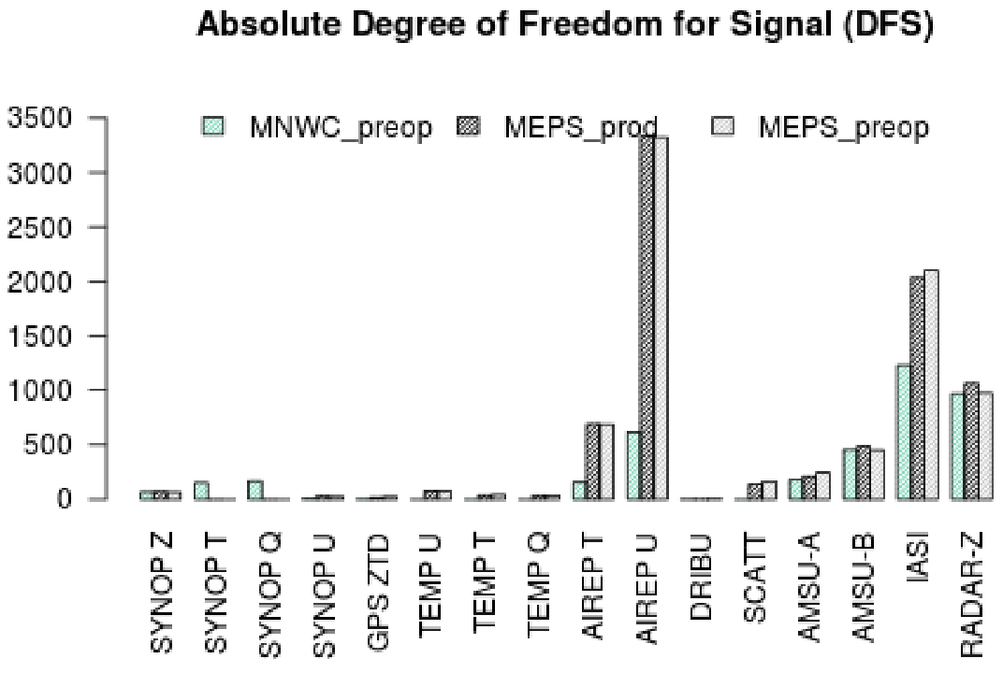
Observation influence diagnostic in the MetCoOp system

